Slide 1

Berkarir di cyber security
Preparations, Activities, Challenges

Slide 2





Hi!
I am Satria Ady Pradana
Cyber Security Consultant at Mitra Integrasi Informatika
Community Leader of Reversing.ID
R&D Member of Indonesia Honeynet Project
Researcher
xathrya
@xathrya
https://xathrya.id
Reversing.ID
Revealing the Truth through Breaking Things

Slide 3
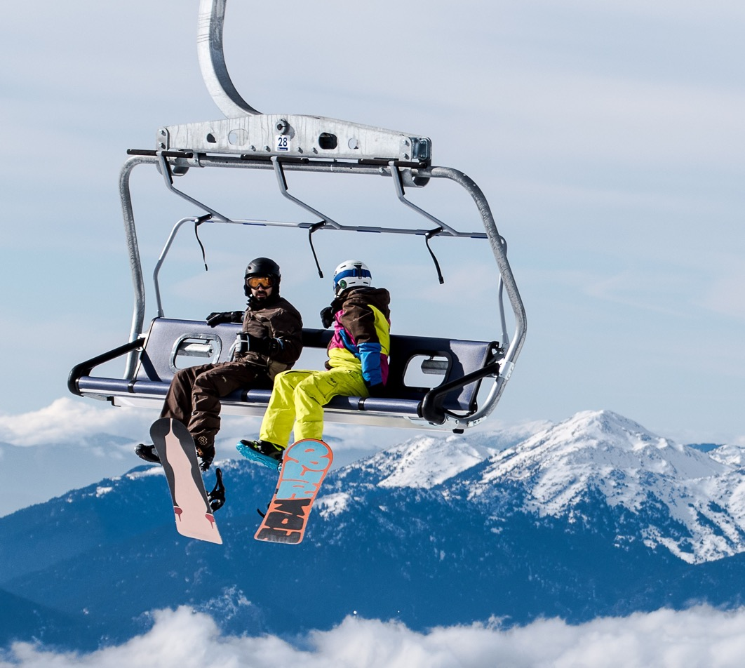
Menjadi Professional
Mengenali profesi
Notes:
© Copyright Showeet.com – Free PowerPoint Templates

Slide 4
(Cyber) Security Professional
(n) Professional who is hired to keep online information of all sorts protected from cyber attacks and other malevolent threats.
In general, they do:
Going through all the system to check for any type of potential issues.
Putting proper security measures and establishing protocols.
Spreading the word about security and its importance.
Security is hot field in Indonesia.
Rapidly growing in demand for qualified people.

Slide 5
Cyber Security Issues in indonesia
Most activities are Jakarta-centric.
Lack of Security Awareness of Multi Stakeholder (government, private sector, academic, BUMN, etc)
Lack of Professionals.
We need more people.

Slide 6
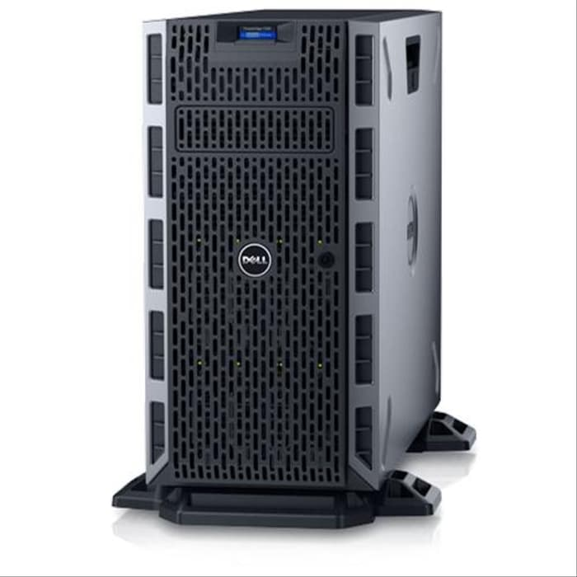

Exploring The jobs (1)
Designing
Testing
Monitoring
Code / Program
Infrastructure

Slide 7

Exploring the jobs (2)
Penetration Tester
Security Engineer
SOC Engineer
Forensic Investigator
Security Auditor
…
etc
Notes:
© Copyright Showeet.com – Free PowerPoint Templates

Slide 8
Exploring the jobs (3)
Penetration Tester
Legally hacking into organization application, networks, and system to discover vulnerabilities and potential damage.
Security Engineer
Designing, building, and maintain IT security solutions.
SOC Engineer
Analyze and respond to security threats from various security platform and technologies.
Forensic Investigator
Investigate the cause of incident, trace all illegal activities on the case, and determine loss from the incident.
Compliance Auditor
Ensuring that an organization is adhering to any regulation relevant to its business.

Slide 9
Preparing as professional
Skills
Communication
Attitude

Slide 10


Choose your faction
Offensive Red Team
Defensive Blue Team

Slide 11
Creating Your Own Virtual Lab
Pentest Lab :
VulnHub, DVWA, bWAPP,
Cyber Defense Lab Blue Team
Detection Lab, Blue Team Training Toolkit, APTSimulator
Joining Online CTF Lab and Challenge Yourself
Pentest Lab :
HackTheBox, Pentestit.ru, Attack Defense Lab
Cyber Defense Lab Blue Team
Attack Defense Lab, SANS Forensic Challenge,

Slide 12
Join Instant Messaging Community (Telegram / Whatsapp / Slack)
Pentester ID (Telegram)
ECHO (Telegram)
Jasakom Perjuangan (Telegram)
Cyber Army (Telegram)
CDEF (Slack)
IT Audit & Security (Telegram)
Indonesia Honeynet Project (Telegram)
Join the Bug Hunting Platform: Cyber Army, Red Storm, BugCrowd, HackerOne, Synack, dll
Join the Discussion forum or related Facebook Group.
Write and publish research as blog post, paper, article, etc.
Attending Cyber Security Conference, Seminar, Workshop, Training.

Slide 13
References
Red Team :
https://www.amanhardikar.com/mindmaps/Practice.html
https://medium.com/mii-cybersec/improving-pentesting-skill-with-intentionally-vulnerable-apps-ece1cdf3dc63
Blue Team :
https://github.com/pe3zx/my-infosec-awesome#adversary-emulation
https://www.amanhardikar.com/mindmaps/Forensics.html

Slide 14
Certification
Should? Should not?
Help employers evaluate potentials new hires.
Recognition of competency.
General? Specialized?
Graduation diploma?

Slide 15
Daily Activities (as Penetration tester)
Find vulnerabilities
Create Proof of Concept
Write a report
Present the result *

Slide 16
Challenges (general)
Must follow security trends, discoveries, and techniques.
CVE
Security Bulletin
Security incidents
Specialization.
Simplify the problem so even non-technical people understand.

Slide 17

QUESTIONS?
xathrya@reversing.id
satria.Pradana@mii.co.id

Slide 18

THANK YOU

